Slide 1
PROJECT TITLE
SHOPPING LIST AND RECIPE DASHBOARD

Slide 2
Project Description
A secure SPA Shopping list application that lets the user add a recipe to the dashboard, edit it or delete it. The application has the unique feature of letting the user add the ingredients from a particular recipe to your shopping list.

Slide 3
Goals of the Project
Integrate Front End and Back end and hence develop a proper MEAN stack application
Implement an application that helps with dealing real life scenarios
Implement Security features like using JWT Token, Auth guards, etc.
Validation of all user input forms
Fetch data from Back end using API

Slide 4
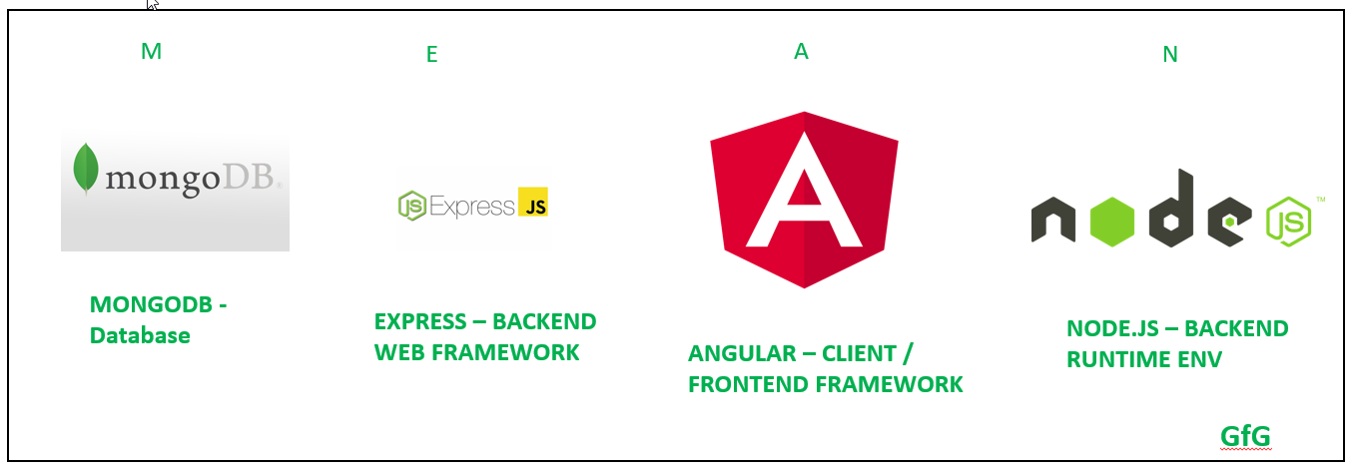
Tech Stack used

Slide 5
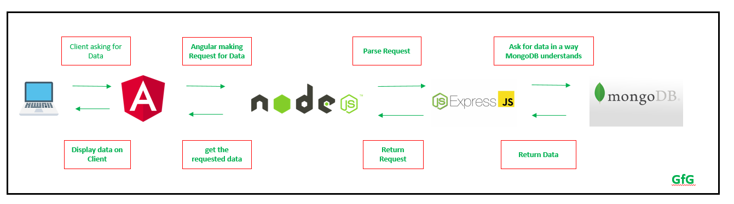
Flow of Data in MEAN Stack Application

Slide 6
Core concepts implemented:
Custom pipes and Directives
Services for major features
TypeScript models like a user model, recipe model
Reactive forms for handling user input with validations
Responsive
Shared module for components, directives, and pipes that can be imported into any feature module.

Slide 7
Frontend: Packages used
Bootstrap :
Sleek, intuitive, and powerful front-end framework for faster and easier web development.

Slide 8
Frontend: Packages used
RxJS: Reactive Extensions For JavaScript
RxJS is a library for composing asynchronous and event-based programs by using observable sequences. It provides one core type, the Observable, satellite types (Observer, Schedulers, Subjects) and operators inspired by Array#extras (map, filter, reduce, every, etc) to allow handling asynchronous events as collections.

Slide 9
Backend: Packages used
Bcrypt.js: Optimized bcrypt in JavaScript with zero dependencies. Compatible to the C++ bcrypt binding on node.js and also working in the browser. Besides incorporating a salt to protect against rainbow table attacks, bcrypt is an adaptive function: over time, the iteration count can be increased to make it slower, so it remains resistant to brute-force search attacks even with increasing computation power.

Slide 10
Backend: Packages used
Body-parser: Node.js body parsing middleware.
Cors: CORS is a node.js package for providing a Connect/Express middleware that can be used to enable CORS with various options.
Express: Fast, unopinionated, minimalist web framework for node.

Slide 11
Backend: Packages used
Jsonwebtoken: An implementation of JSON Web Tokens.
Lodash: A modern JavaScript utility library delivering modularity, performance & extras.
Mongoose: Mongoose is a MongoDB object modeling tool designed to work in an asynchronous environment. Mongoose supports both promises and callbacks.
Passport: Passport is Express-compatible authentication middleware for Node.js.
Passport-local: Local username and password authentication strategy for Passport

Slide 12
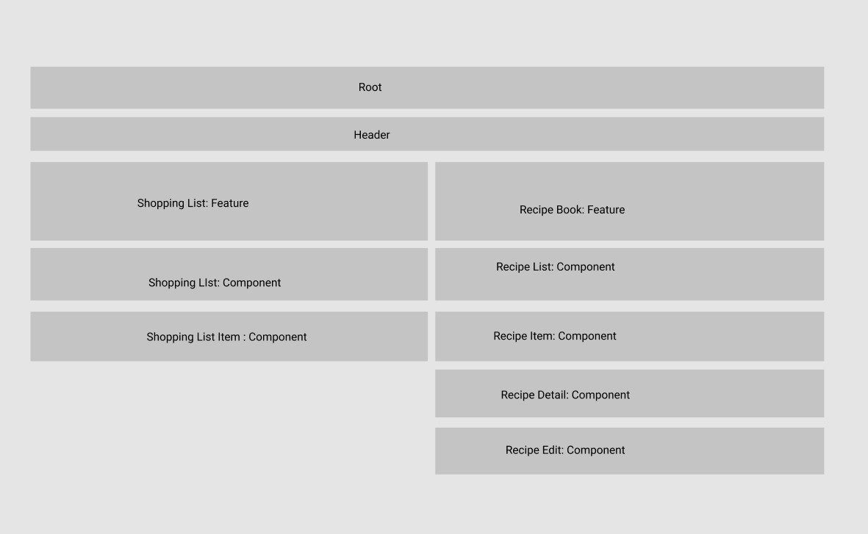
Component Architecture

Slide 13
Thank You

